Slide 1
FACE RECOGNITION USING IMAGE PROCESSING.
BATCH- IT-1
K.V.Hemanth -207Z1A1225
Sheldon Shaji -207Z1A1241
V.Nikil -207Z1A1248
Under Guidance :
Mr. T. Madhu

Slide 2

Data Flow Diagram
A Data Flow Diagram is a visual representation that illustrates how data flows through a system.
It shows the inputs, processors, and outputs of a system and the data stores that are used to store and retrieve data.
A Data Flow diagram is a traditional visual representation of the information flows within a system.
It shows how data enters and leaves the system, what changes the information, and where data is stored.

Slide 3
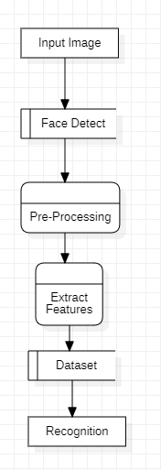
Fig : Data Flow Diagram

Slide 4
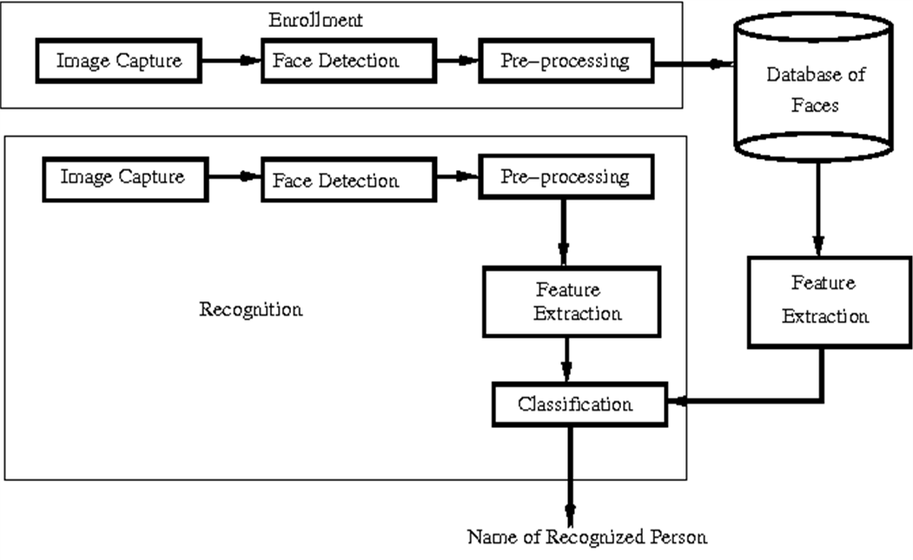
Architecture

Slide 5
UML CONCEPTS
The Unified Modelling Language (UML) is a standard language for writing software blue prints.
The UML is a language for
Visualizing
Specifying
Constructing
Documenting the artifacts of a software intensive system.

Slide 6
UML DIAGRAMS
Use Case Diagram
Class Diagram
Sequence Diagram
Activity Diagram
Component Diagram
Deployment Diagram

Slide 7
Use Case Diagram
In the Unified Modeling Language (UML), a use case diagram can summarize the details of system's users (also known as actors) and their interactions with the system.
The purpose of a use case diagram in UML is to demonstrate the different ways that a user might interact with a system.

Slide 8
IMAGE
FACE DETECT
PREPROCESSING
FEATURE EXTRACTION
USER
CLASSIFICATION
<<include>>
TEST IMAGE
RECOGNITION
Fig : Use case Diagram

Slide 9
Class Diagram
Class diagram in the Unified Modeling Language (UML) is a type of static structure diagram that describes the structure of a system by showing the system's classes, their attributes, operations (or methods), and the relationships among objects.
A class is a representation of an object and, in many ways; it is simply a template from which objects are created.

Slide 10
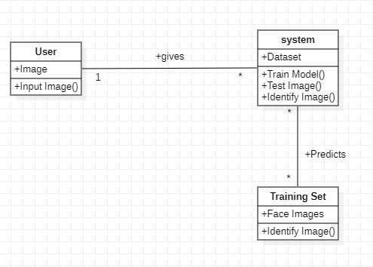
Fig : Class Diagram

Slide 11
Sequence Diagram
A sequence diagram simply depicts interaction between objects in a sequential ordering.
Sequence diagrams describe how and in what order the objects in a system function.

Slide 12
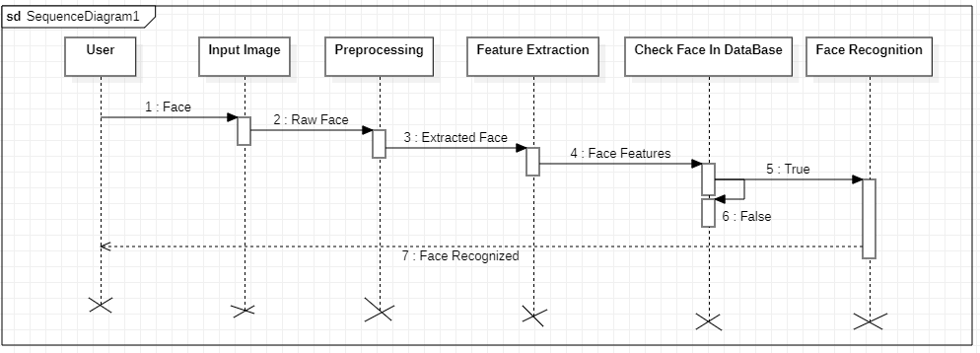
Fig : Sequence Diagram

Slide 13
Activity Diagram
Activity diagram is another important behavioral diagram in UML diagram to describe dynamic aspects of the system.
Activity diagram is essentially an advanced version of flow chart that modeling the flow from one activity to another activity.

Slide 14
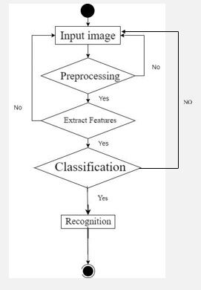
Fig : Activity Diagram

